Slide 1

Seattle Airbnb
Open Data
Arif Romadhan
arifromadhan19@gmail.com
+6285294569271

Slide 2
Airbnb : airBnB is an online service that provides rental services for homes or apartments spread across various parts of the world
there are host listing data that have various characteristics where the data affects the rating obtained. from those case, we will analyze the potential that the host has to increase and provide recommendations to users
Inspiration :
Data Analysis to describe the vibe of each Seattle neighborhood
Busiest Times, New Listings and Total Airbnb Visitors Analysis
Generate insight and recommendations
TLDR
Notes:
Empathize, define, ideate, prototype, test Lebih beratin ke emphatize, state kalau we need them on ideate phase to inform design decision & test phase to evaluate design. And note that they can actually jump in.

Slide 3
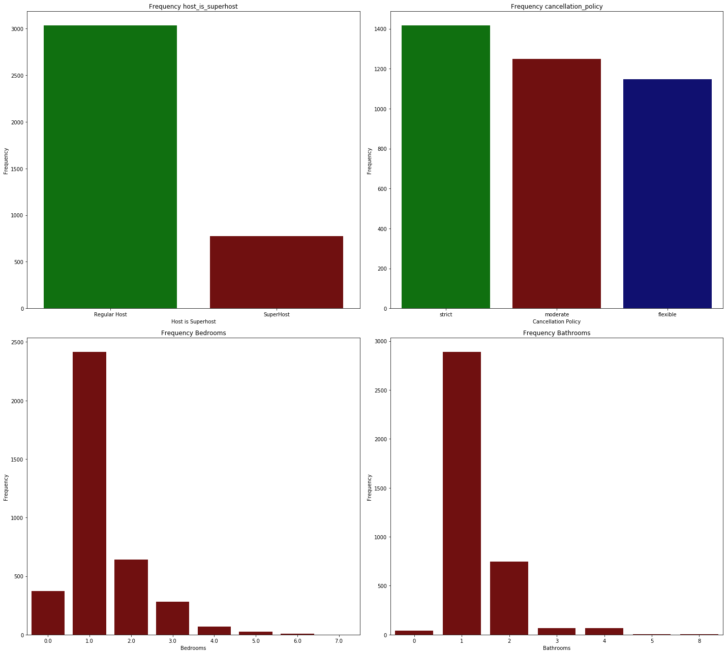
Exploratory Data Analysis (1)
Insight of feature
Host_is_superhost : SuperHost (21%) has a lower number than Regular Host (79%)
Cancellation_policy : most hosts in Seattle have strict (37%) cancellation policy, while moderate (32%) and flexible (30%)
Bedrooms : Hosts that only have 1 bedrooms are very dominant (63%) in Seattle.
Bathrooms : hosts that only have 1 bathroom are very dominant (75%) in Seattle but there are irregularities where there are hosts who don't have bathrooms
Notes:
Empathize, define, ideate, prototype, test Lebih beratin ke emphatize, state kalau we need them on ideate phase to inform design decision & test phase to evaluate design. And note that they can actually jump in.

Slide 4
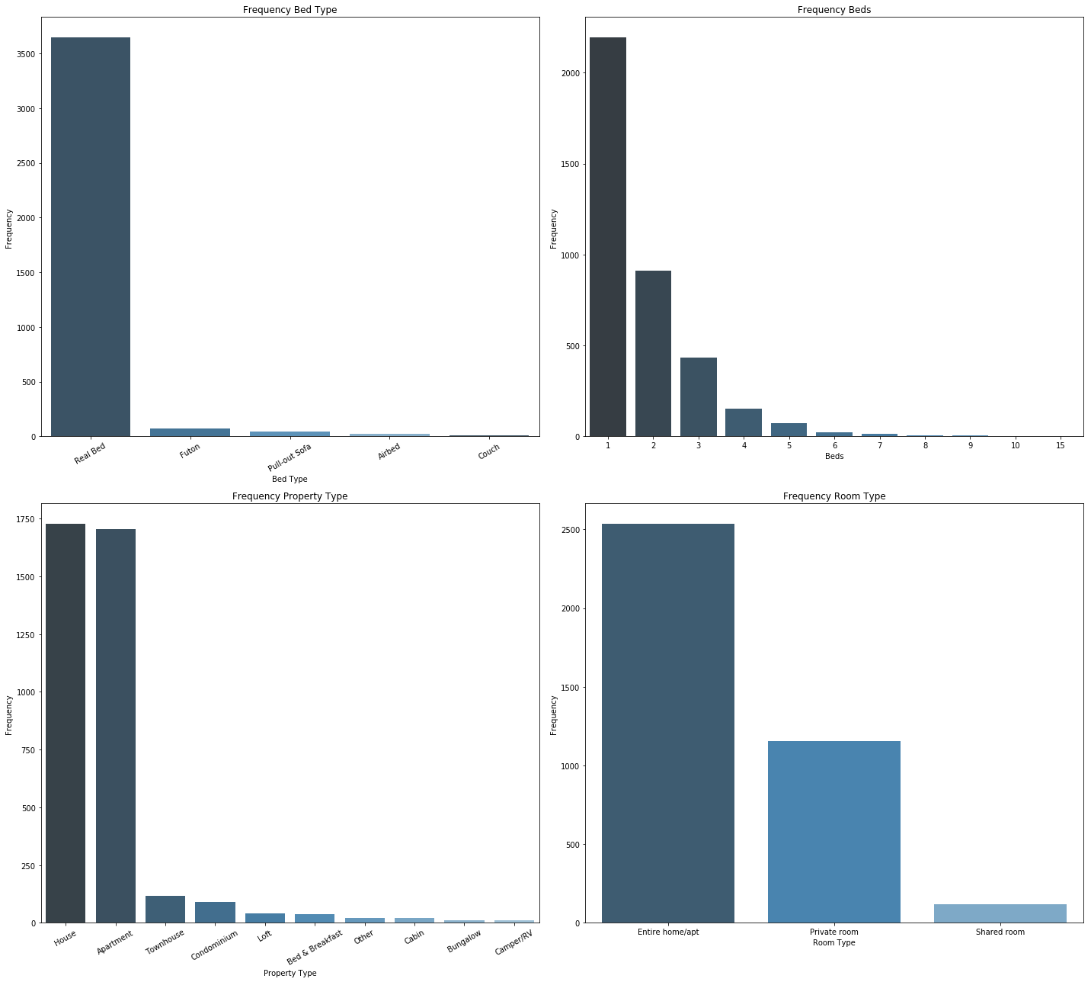
Exploratory Data Analysis (2)
Insight of feature
bed_type: the use of real beds is very dominant in Seattle to reach 95%
beds : hosts with 1 bed have a high percentage of 57%
property_type : Hosts that only have 1 bedrooms are very dominant in Seattle.
room_type : houses (46%) and apartments (44%) become users' choice in choosing accommodation
Notes:
Empathize, define, ideate, prototype, test Lebih beratin ke emphatize, state kalau we need them on ideate phase to inform design decision & test phase to evaluate design. And note that they can actually jump in.

Slide 5
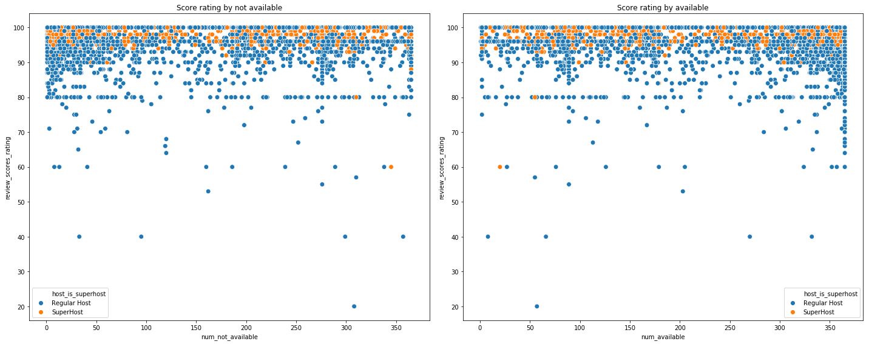
Available - Non Available Performance
Notes:
Empathize, define, ideate, prototype, test Lebih beratin ke emphatize, state kalau we need them on ideate phase to inform design decision & test phase to evaluate design. And note that they can actually jump in.

Slide 6
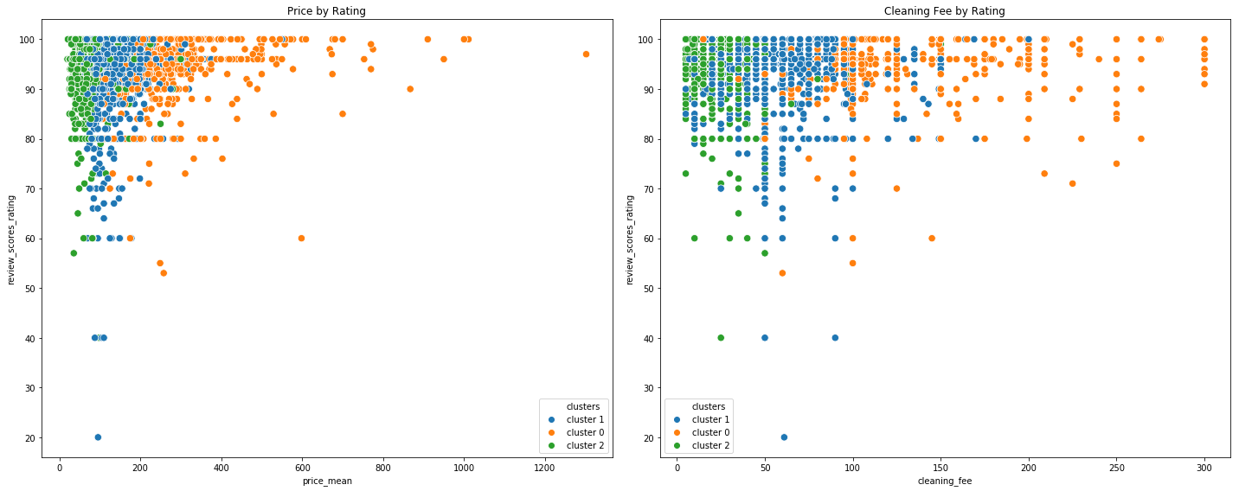
Clustering
Notes:
Empathize, define, ideate, prototype, test Lebih beratin ke emphatize, state kalau we need them on ideate phase to inform design decision & test phase to evaluate design. And note that they can actually jump in.

Slide 7
EDA and Clustering Insight
Insight of feature
Hosts that have high frequency available, have a high rating score too. It is hoped that hosts in Seattle will often rent out their homes to get positive feedback from users
The superhost rating score tends to be better, to satisfy users, the superhost number must be increased
There are several hosts with cheap rental prices in cluster 2 but have a high rating rating.
There are several hosts with amenities in cluster 2 that are not very complete but have a high rating value
Airbnb can retrieve pattern hosts with good performance (eg pattern cluster 2) and encourage other hosts to be like hosts in cluster 2
Notes:
Empathize, define, ideate, prototype, test Lebih beratin ke emphatize, state kalau we need them on ideate phase to inform design decision & test phase to evaluate design. And note that they can actually jump in.

Slide 8
Insight of feature
bathrooms 2, bedrooms 1, beds 1, median and mean security deposit 240 - 250, median and mean cleaning fee 36 - 45, room type private, superhost number around 20%, the average number of amenities is 23.
If there are hosts who have 2 bathroom facilities, bedrooms 1, beds 1, amenities under 23, it is expected that the host has a price between 69-75, security deposit between 240-250, cleaning fee between 36-45, and they are expected to be superhost
It is expected that available amounts are between 270-342
Recommendation
by Cluster 2
Criteria
Notes:
Empathize, define, ideate, prototype, test Lebih beratin ke emphatize, state kalau we need them on ideate phase to inform design decision & test phase to evaluate design. And note that they can actually jump in.

Slide 9
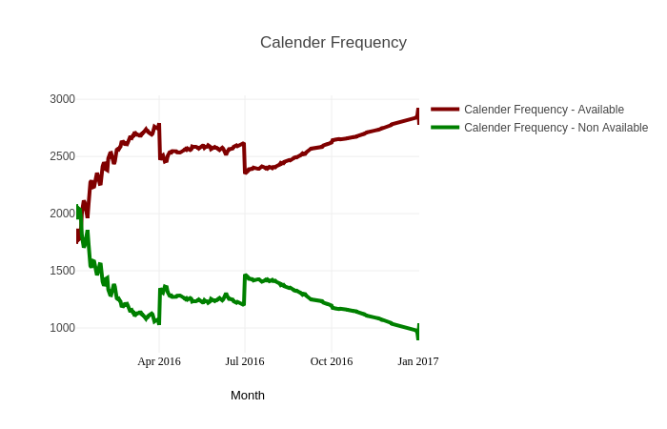
Busiest Times Analysis - by Days
Analysis 3
There are 3x busiest time, i.e.
1 april 2016 within 2790
28 juni 2016 within 2616
1 jan 2017 within 2922
When the busiest time occurs, many hosts "inactive" their service
Recommendation :
Airbnb invites host providers to open their services at the busiest time, one of which is by giving rewards.
Notes:
Empathize, define, ideate, prototype, test Lebih beratin ke emphatize, state kalau we need them on ideate phase to inform design decision & test phase to evaluate design. And note that they can actually jump in.

Slide 10
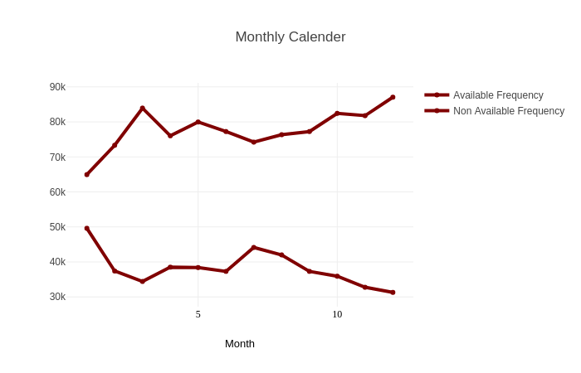
Busiest Times Frequency - by Month
Analysis 3
busiest time in months 3, 5, 10 and 12 with an average frequency of 79.971k - 87,061k
When the busiest time occurs, many hosts "inactive" their service
Recommendation :
Airbnb provides promos or rewards on the 3rd, 5th, 10th, and 12th month to host providers, so that they are interested in active / available at the busiest time
Notes:
Empathize, define, ideate, prototype, test Lebih beratin ke emphatize, state kalau we need them on ideate phase to inform design decision & test phase to evaluate design. And note that they can actually jump in.

Slide 11
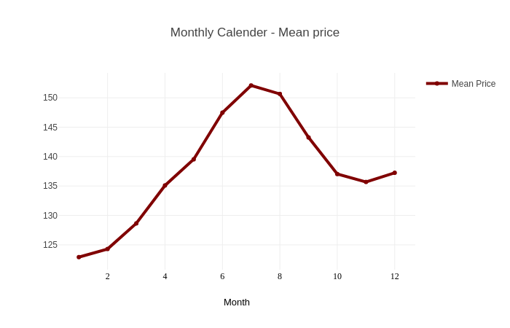
Monthly Price Average
Analysis 3
There was a price increase in the 6th, 7th and 8th months which still had a fairly high price. If we compare it with the busiest time, when the price increase the busiest time decreases and when the price decrease the busiest time occurs.
Recommendation :
When prices increase, Airbnb can direct users to low-cost, good-value hosts
When prices decline, Airbnb can provide information to users so that they are interested in the price decrease
Notes:
Empathize, define, ideate, prototype, test Lebih beratin ke emphatize, state kalau we need them on ideate phase to inform design decision & test phase to evaluate design. And note that they can actually jump in.

Slide 12
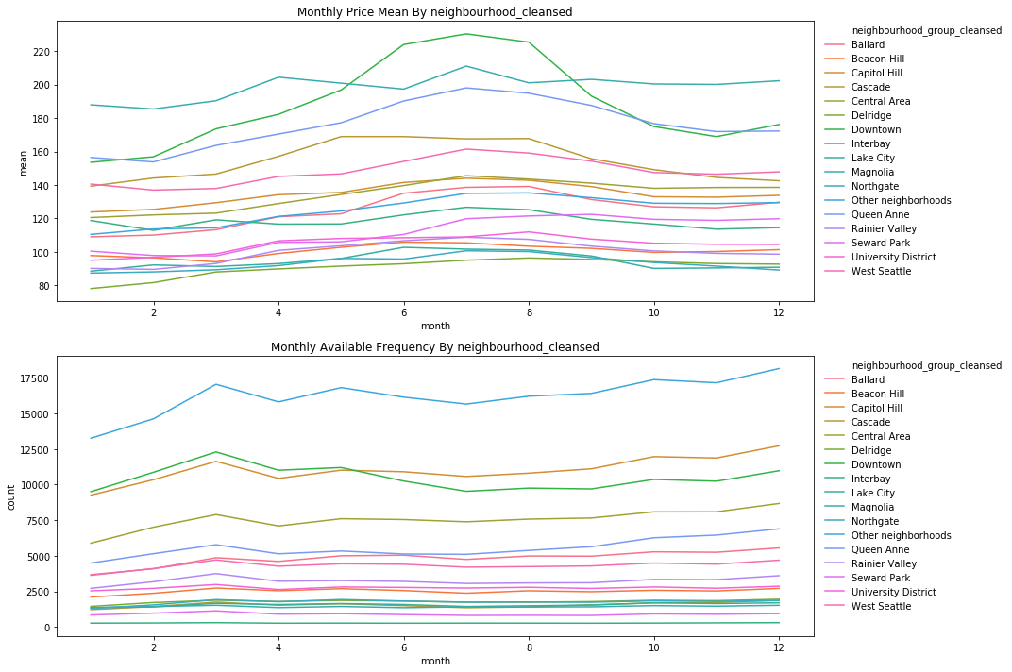
Busiest Time by Neighbourhood Group Cleansed (1)
Analysis 3
Notes:
Empathize, define, ideate, prototype, test Lebih beratin ke emphatize, state kalau we need them on ideate phase to inform design decision & test phase to evaluate design. And note that they can actually jump in.

Slide 13
Busiest Time by Neighbourhood Group Cleansed (2)
If we analyze price increases by area, Downtown, Magnolia, and Queen Anne to be the top 3 which has a similarity pattern with general price increases
If we analyze by frequency price increases, Other neighborhoods, Capitol Hill, Downtown becomes top 3 which has a similarity pattern with busiest time in general
Recommendation :
When prices increase, Airbnb can direct users to cheaper hosts in other regions but have a good rating and the distance is still affordable
When there is a price increase, Airbnb can provide a good tourist alternative in other areas that do not experience significant price increases
The same thing can be applied with the busiest time case
Notes:
Empathize, define, ideate, prototype, test Lebih beratin ke emphatize, state kalau we need them on ideate phase to inform design decision & test phase to evaluate design. And note that they can actually jump in.

Slide 14

Arif Romadhan
arifromadhan19@gmail.com
+6285294569271
Notes:
Empathize, define, ideate, prototype, test Lebih beratin ke emphatize, state kalau we need them on ideate phase to inform design decision & test phase to evaluate design. And note that they can actually jump in.

